Slide 1
Azure Hands-on Lab: VNet Peering & VM Connectivity Azure VNet Peering allows you to connect two virtual networks (VNets) so that resources in each network can communicate through Azure's private backbone network and provide Low latency and high-speed
Create 2 Vnets
Core-VNet: 10.30.0.0/16
Stg-VNet: 10.40.0.0/16 (ARM Template )
Create 2 VMs
Core-VM in Core-VNet
Stg-VM in Stg-VNet
Test Initial Connectivity Using Network Watcher > Connection Troubleshoot
Configure VNet Peering from core-vnet to stg-vnet
Test Connectivity Again Using Network Watcher

Slide 2
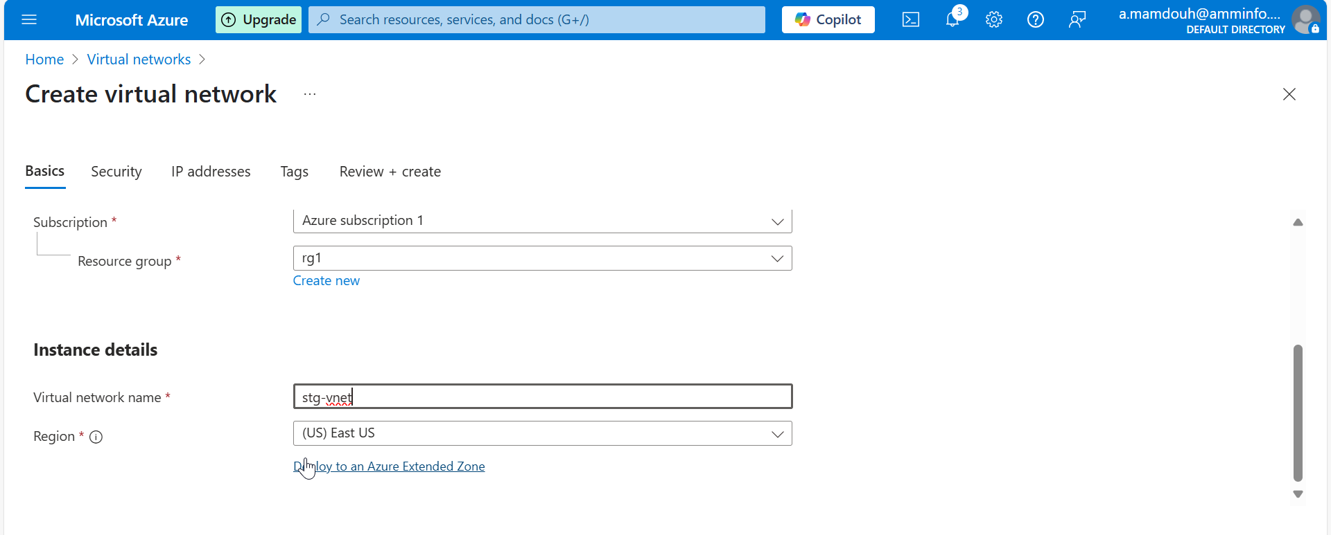
Notes:
Create RG & Vnet

Slide 3
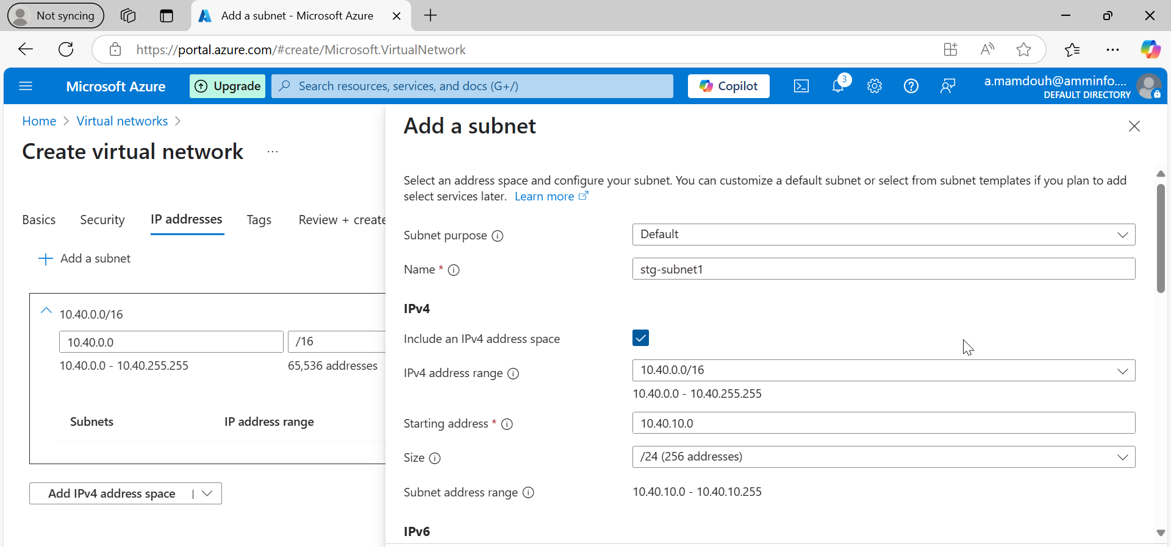
Notes:
Create stg-vnet with address space and 2 subnet as shown

Slide 4
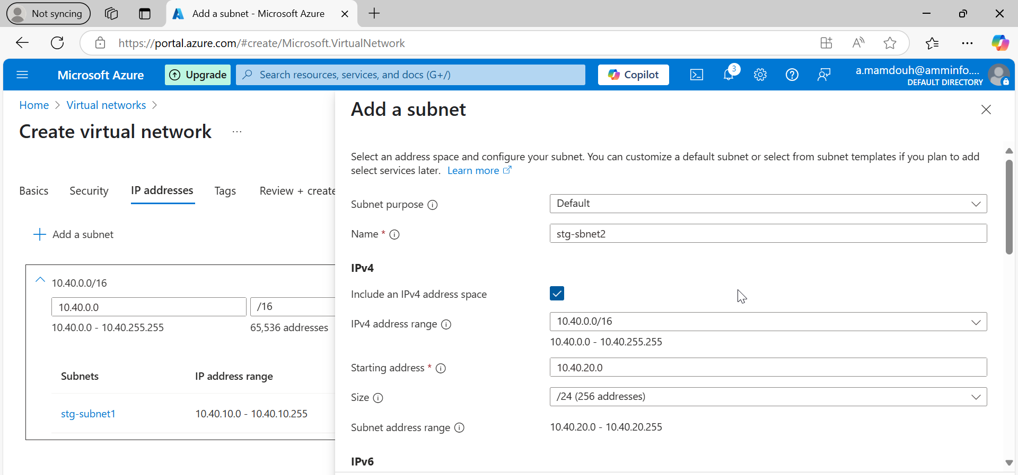
Notes:
Add second subnet

Slide 5
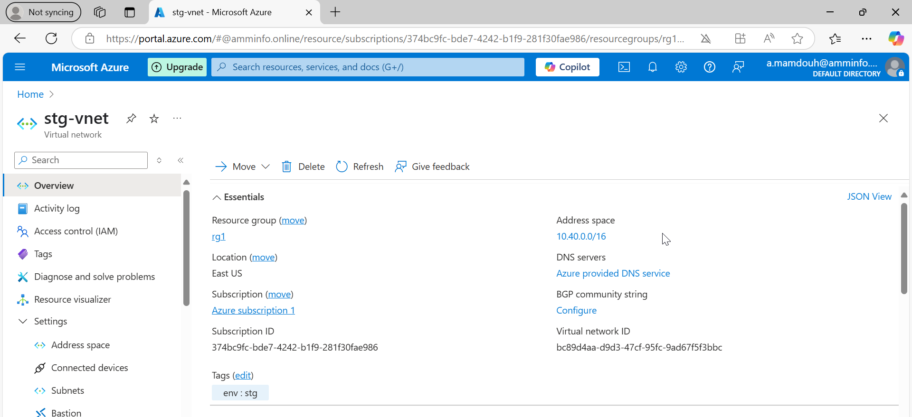

Slide 6
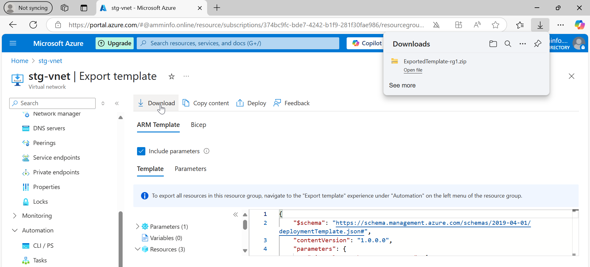
Notes:
Export json template from stg-vnet which I created via portal and download it locally

Slide 7
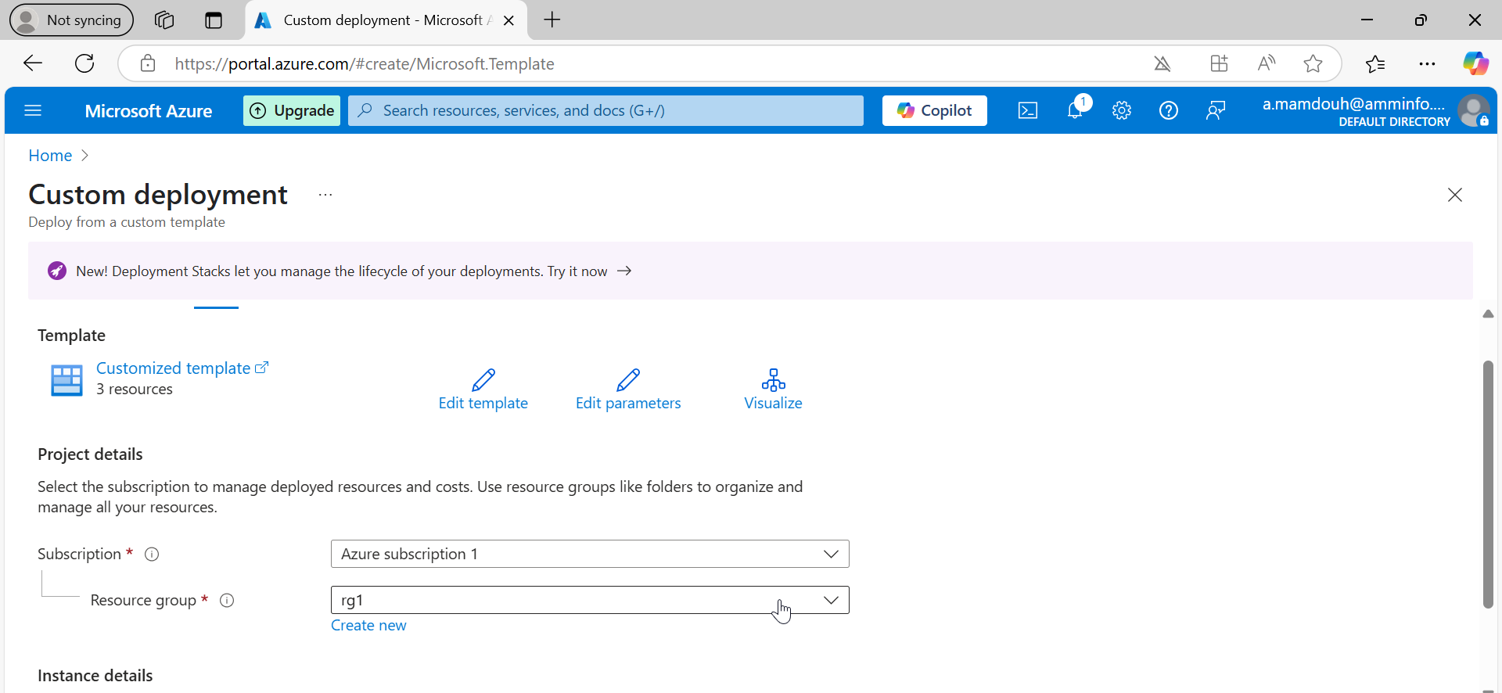
Notes:
Search for custom deployment to upload your json files after editing in parameters such as vnet name-address psace – subnet

Slide 8
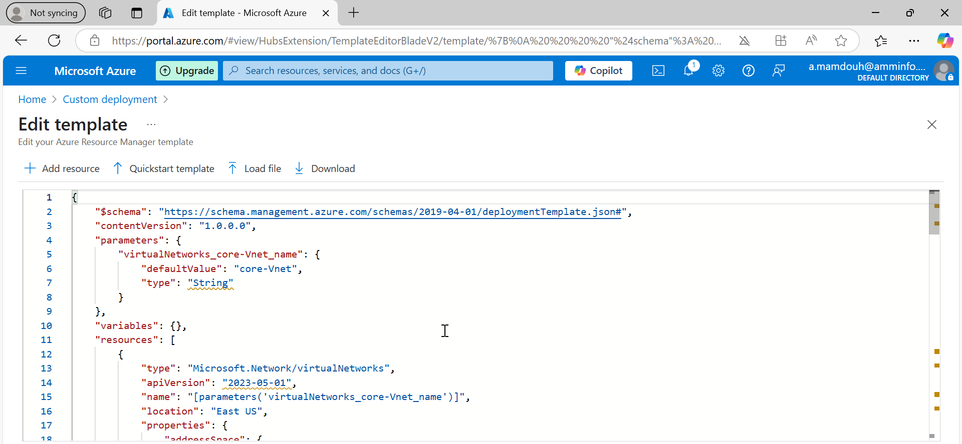
Notes:
Upload template and parameter files which I exported before

Slide 9
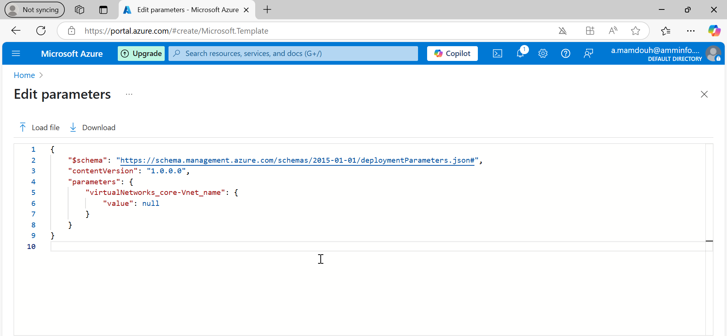
Notes:
Change parameters in Json like vnet name, add space and subnet

Slide 10
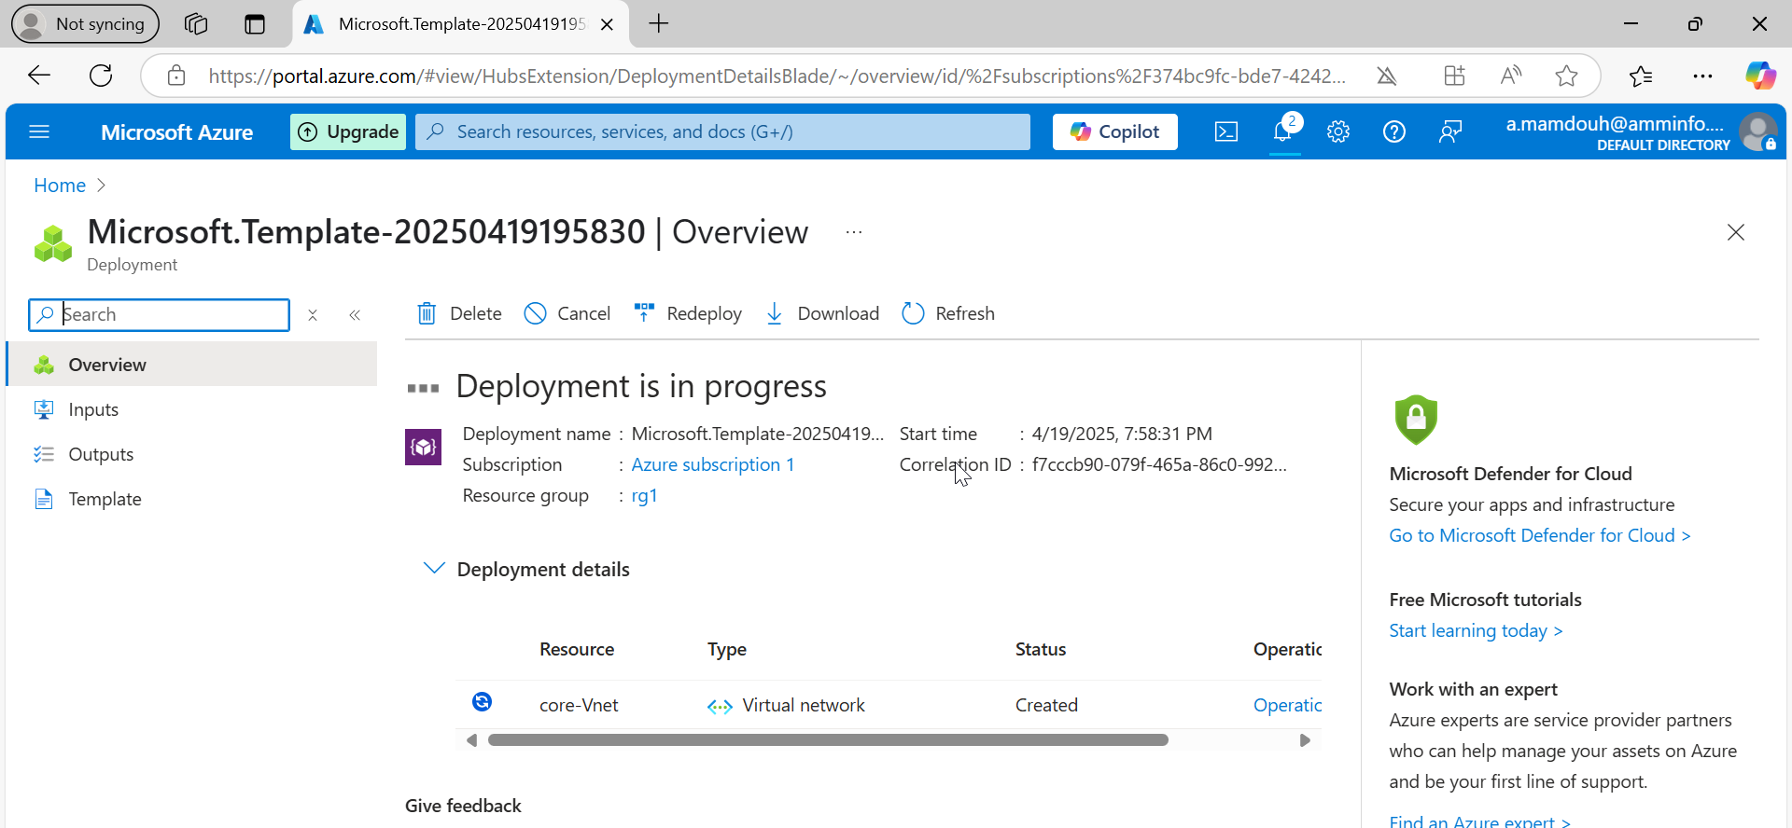

Slide 11
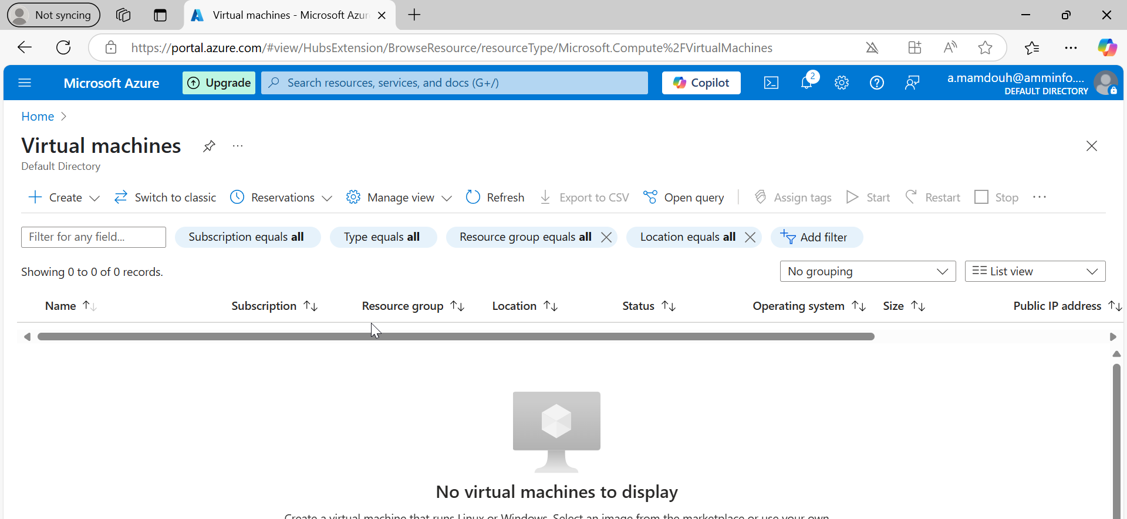
Notes:
Create a new vm

Slide 12
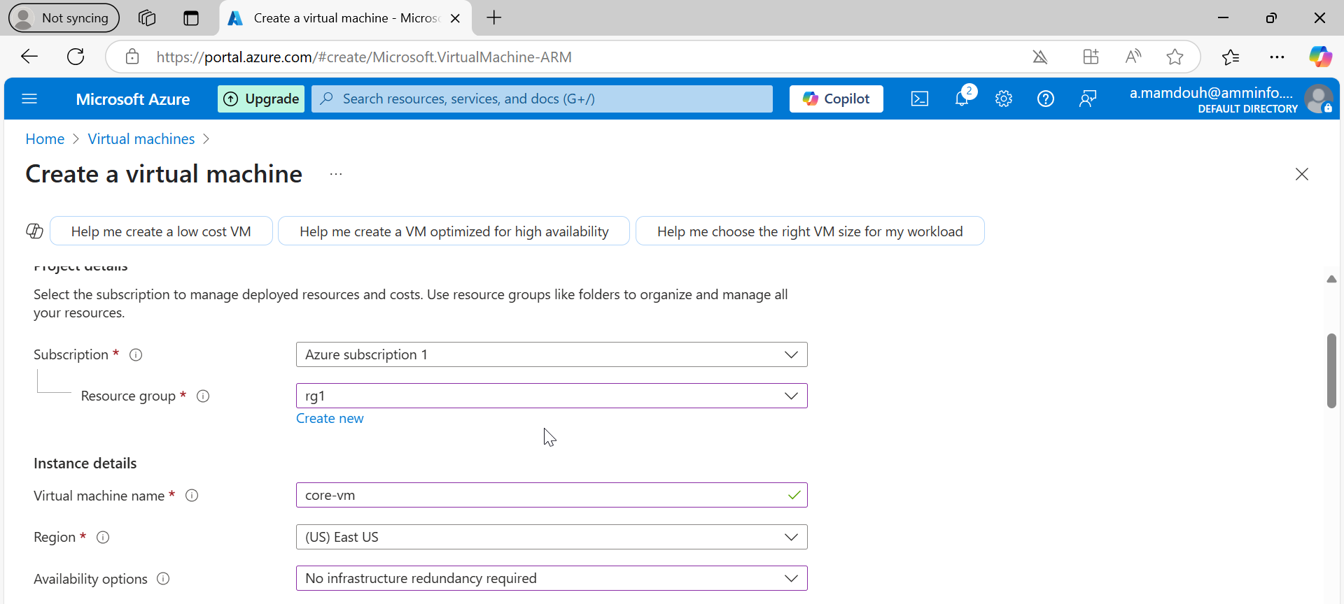
Notes:
Vm name “core-vm”

Slide 13
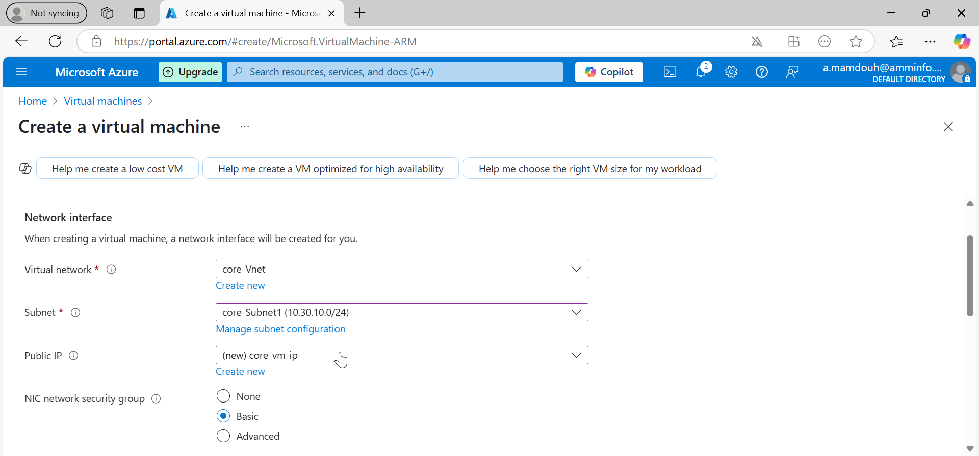
Notes:
Specify vnet and subnet for your vm core-vnet-subnet ”10.30.10.0”

Slide 14
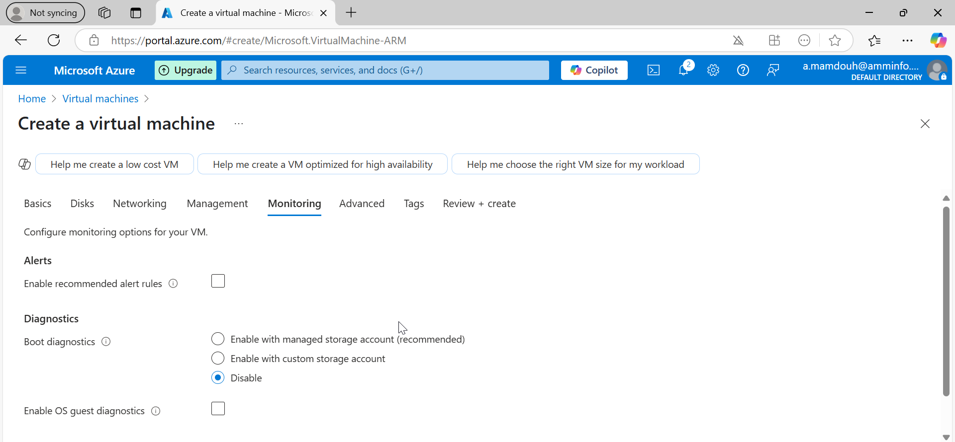

Slide 15
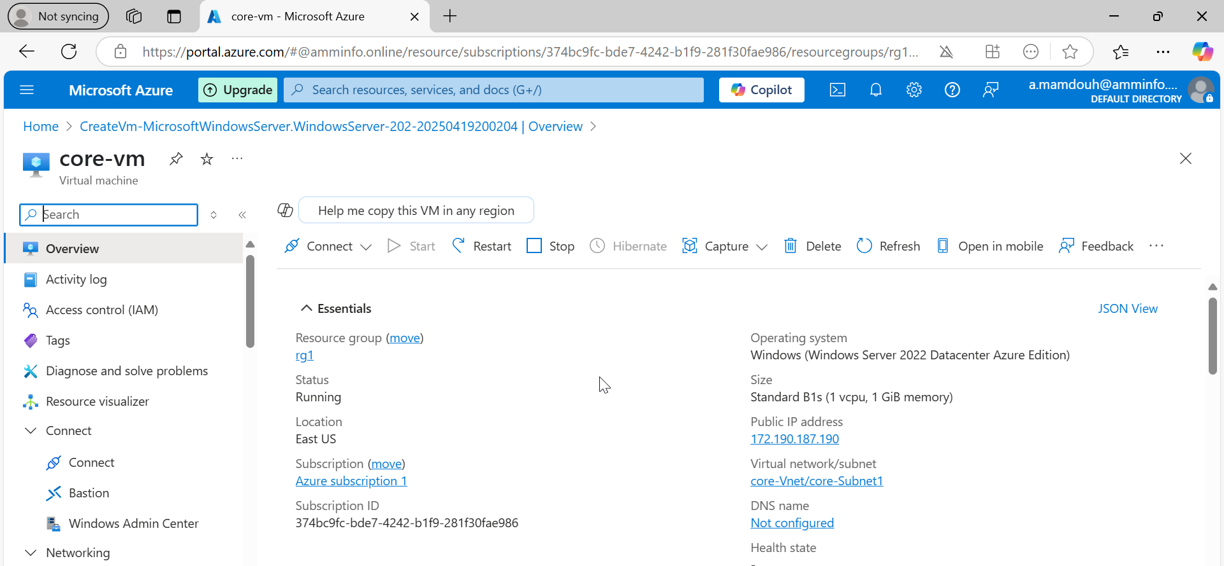

Slide 16
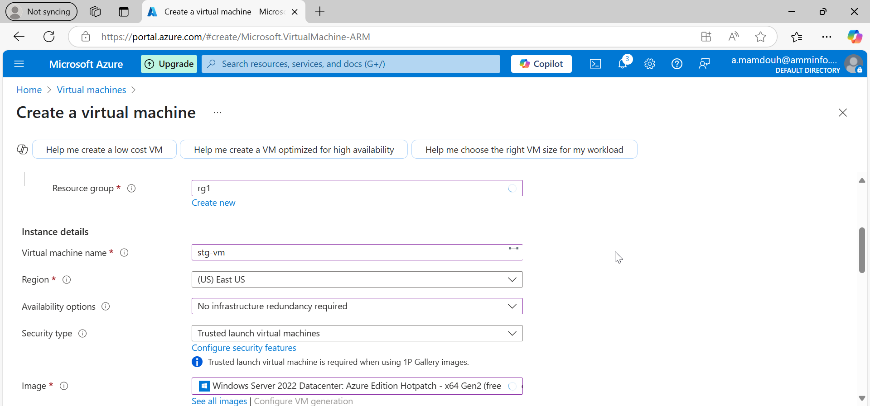
Notes:
Create a second vm “stg-vm”

Slide 17
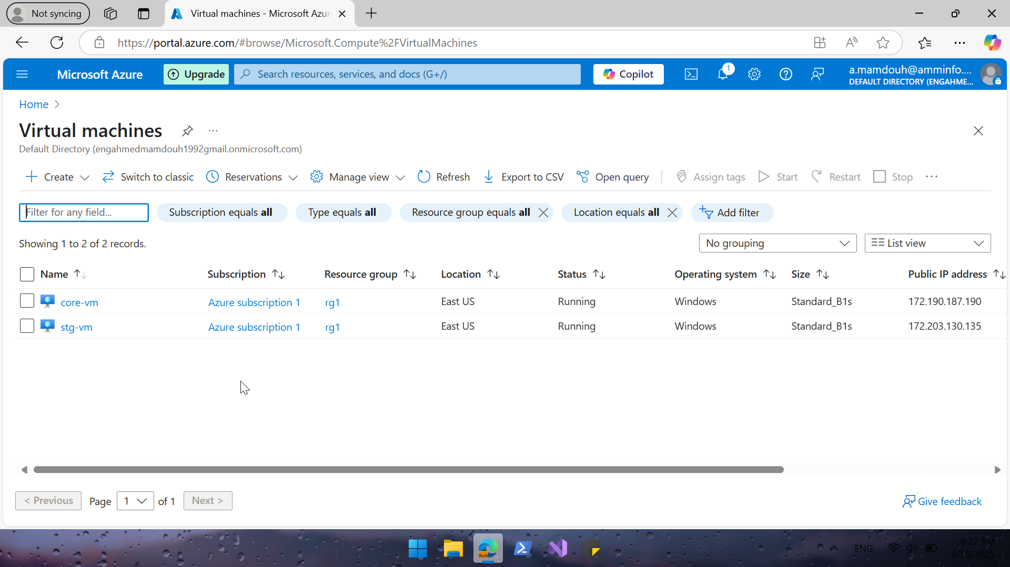
Notes:
vms are up and running

Slide 18
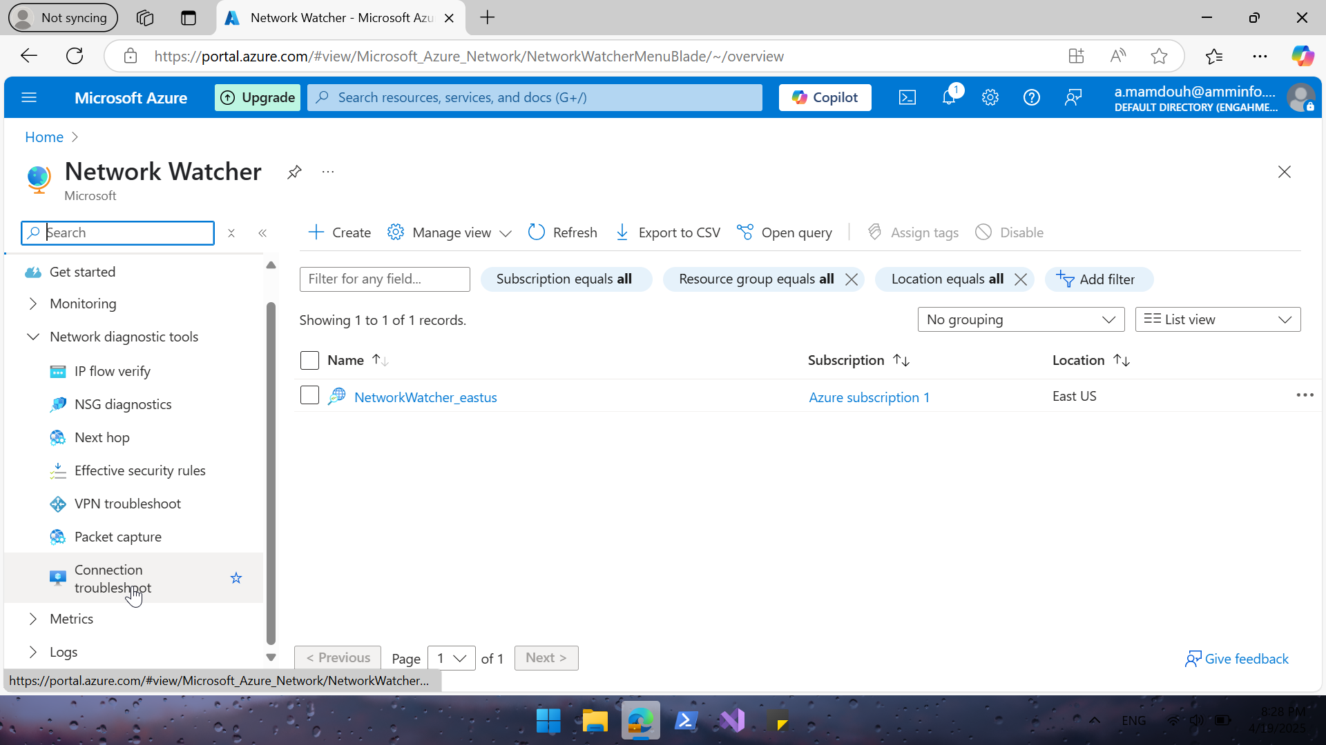
Notes:
Search for network watcher to test connectivity between 2 vms

Slide 19
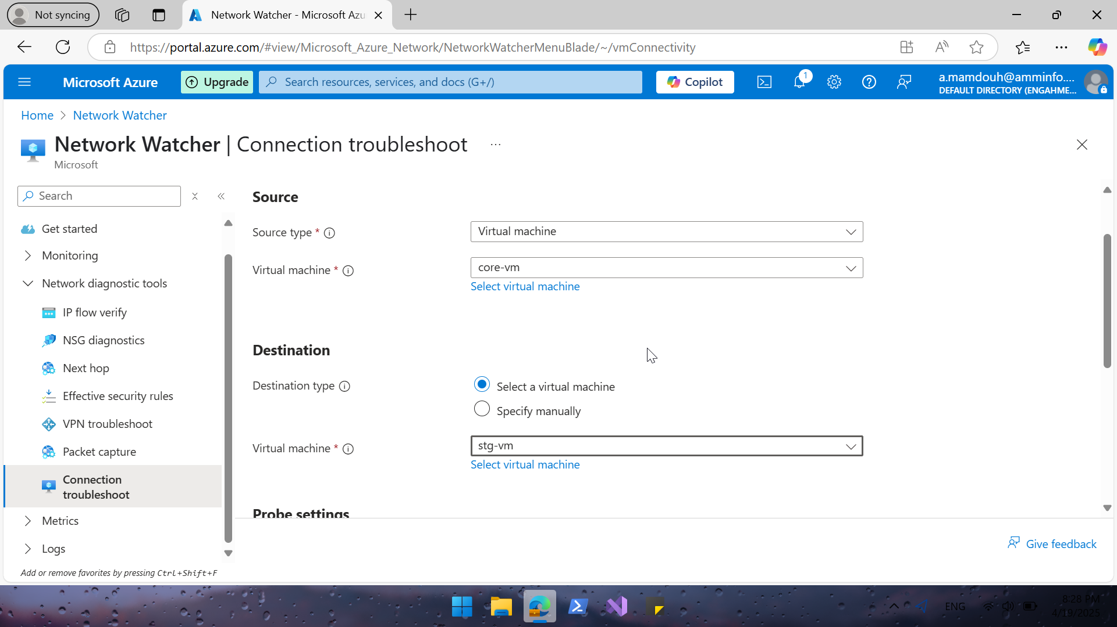
Notes:
Create connection troubleshoot to test connectivity between 2 vms

Slide 20
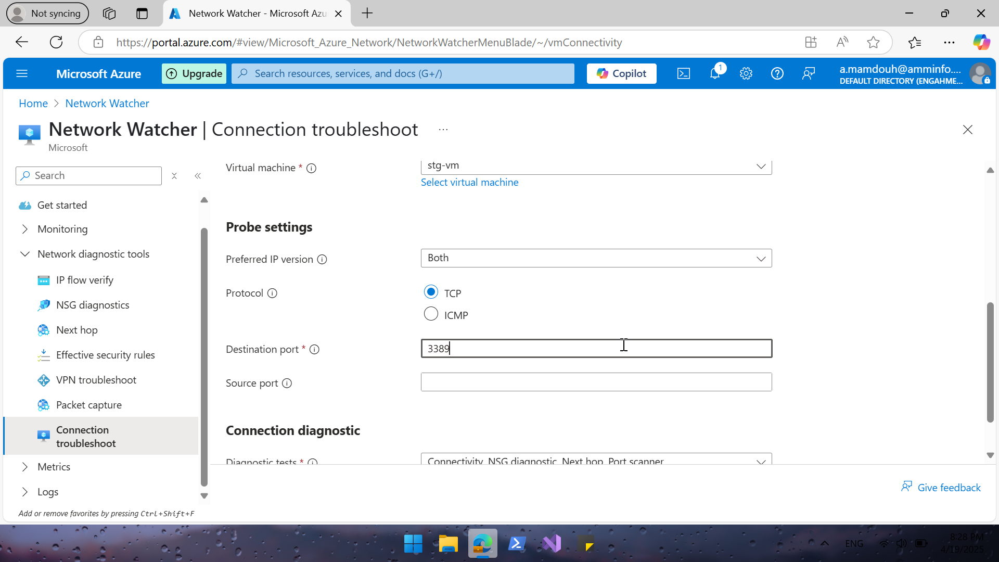
Notes:
test connectivity on 3389 (RDP)

Slide 21
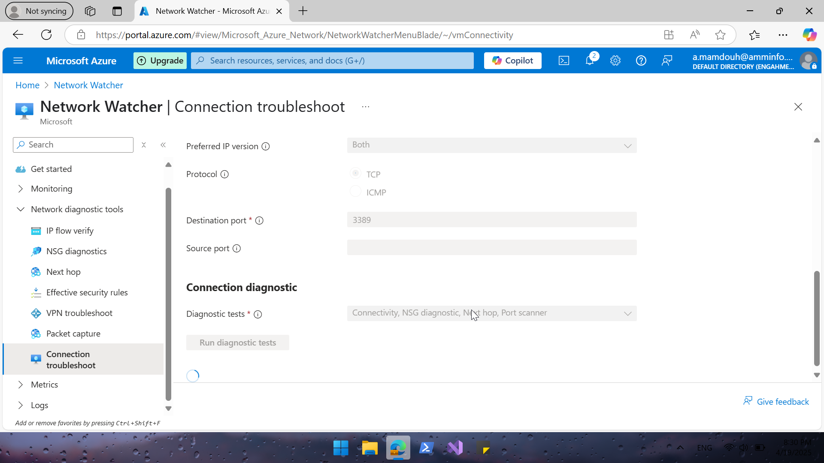

Slide 22
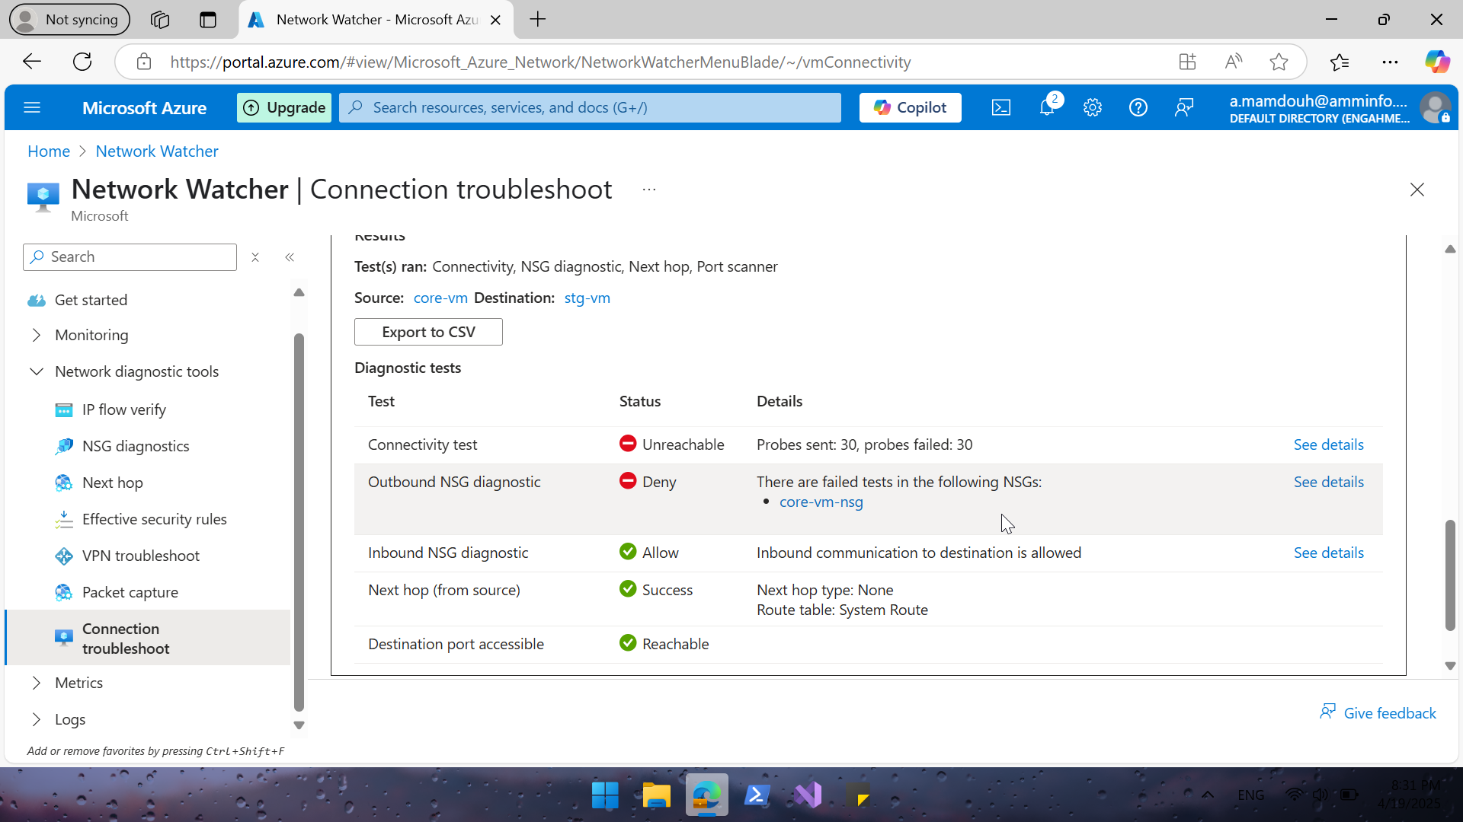
Notes:
Connection failed

Slide 23
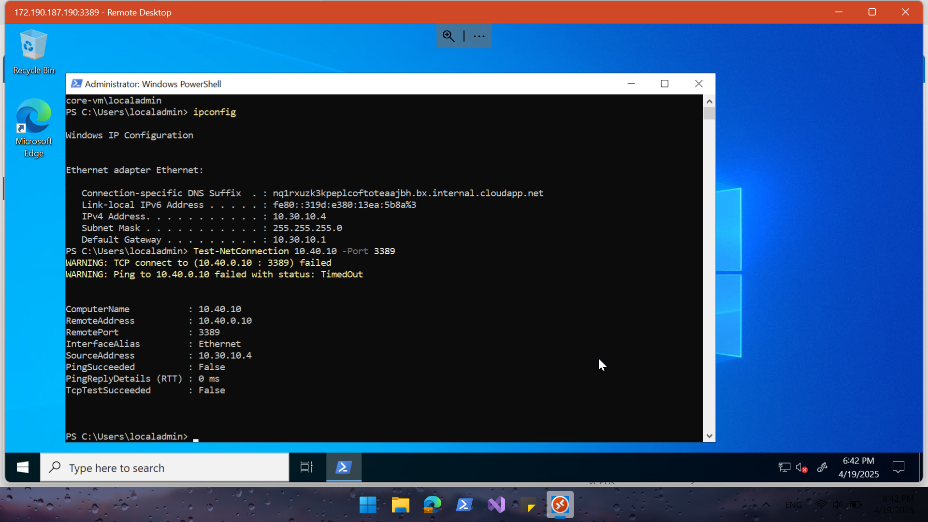
Notes:
RDP to core cm and use test-netconnection – port to test connection to Stg-vm in another vnet on port 3389 | connection failed

Slide 24
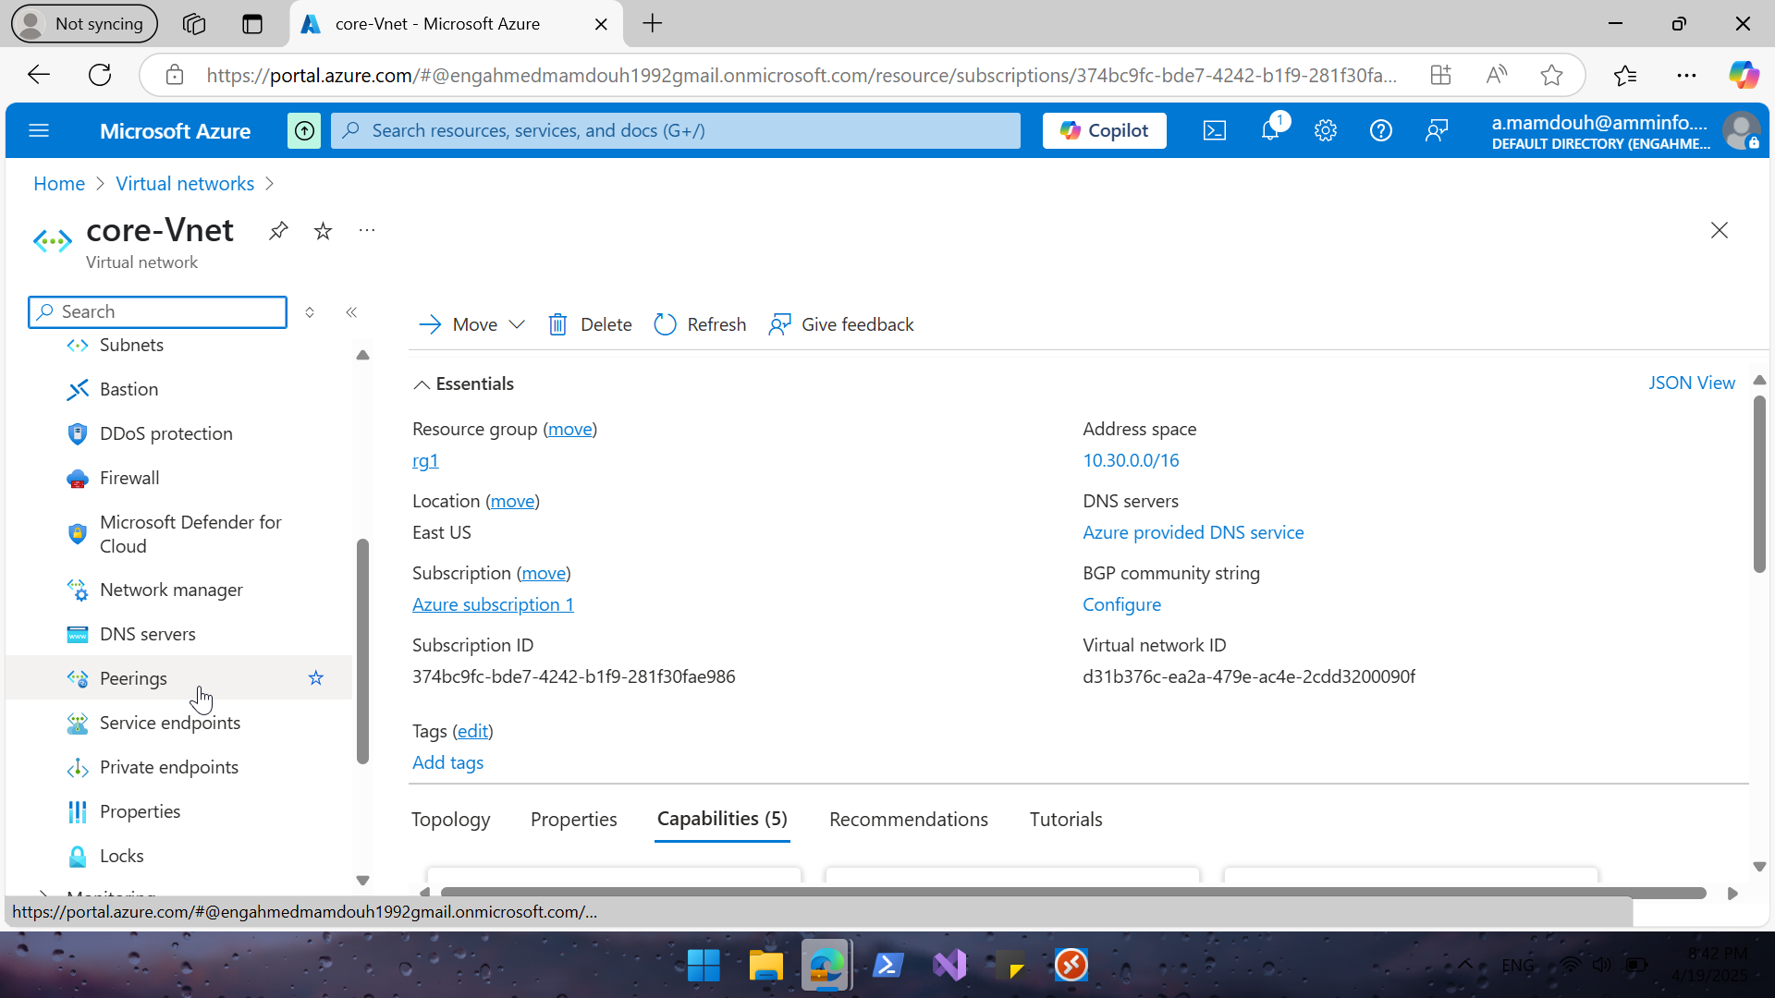
Notes:
Configure peering between 2 vnet "You can connect VNets to each other using VNet peering or a VPN gateway to enable communication between resources across different virtual networks

Slide 25
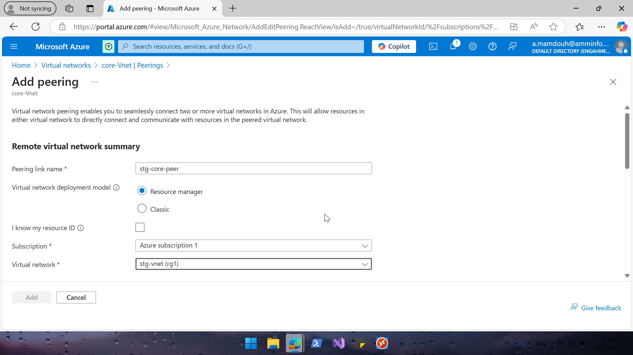
Notes:
Add remote vnet

Slide 26
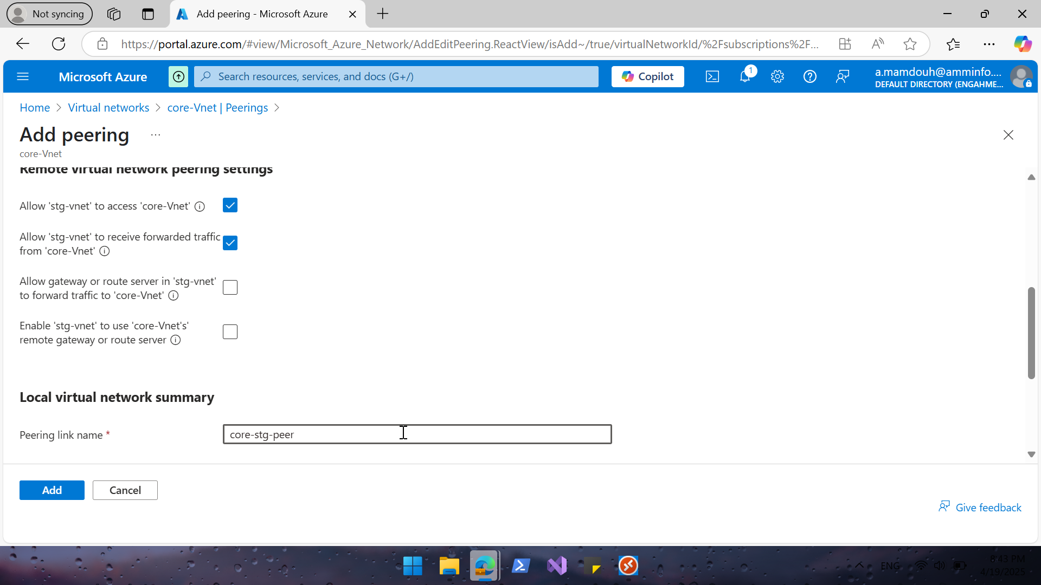
Notes:
Allow traffic on two ways

Slide 27
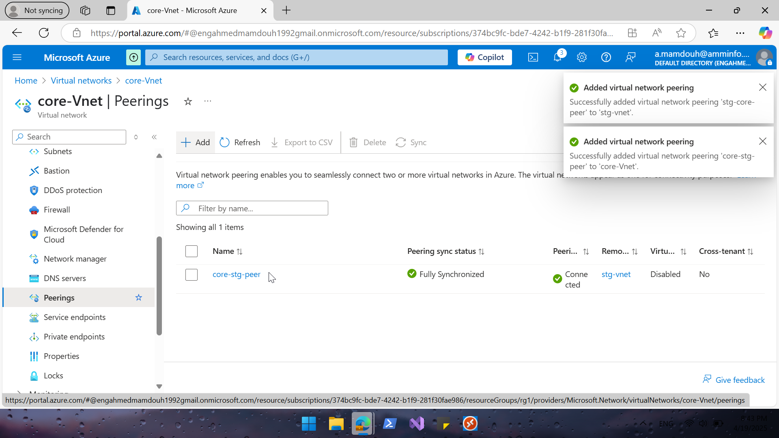
Notes:
Peering is configured

Slide 28
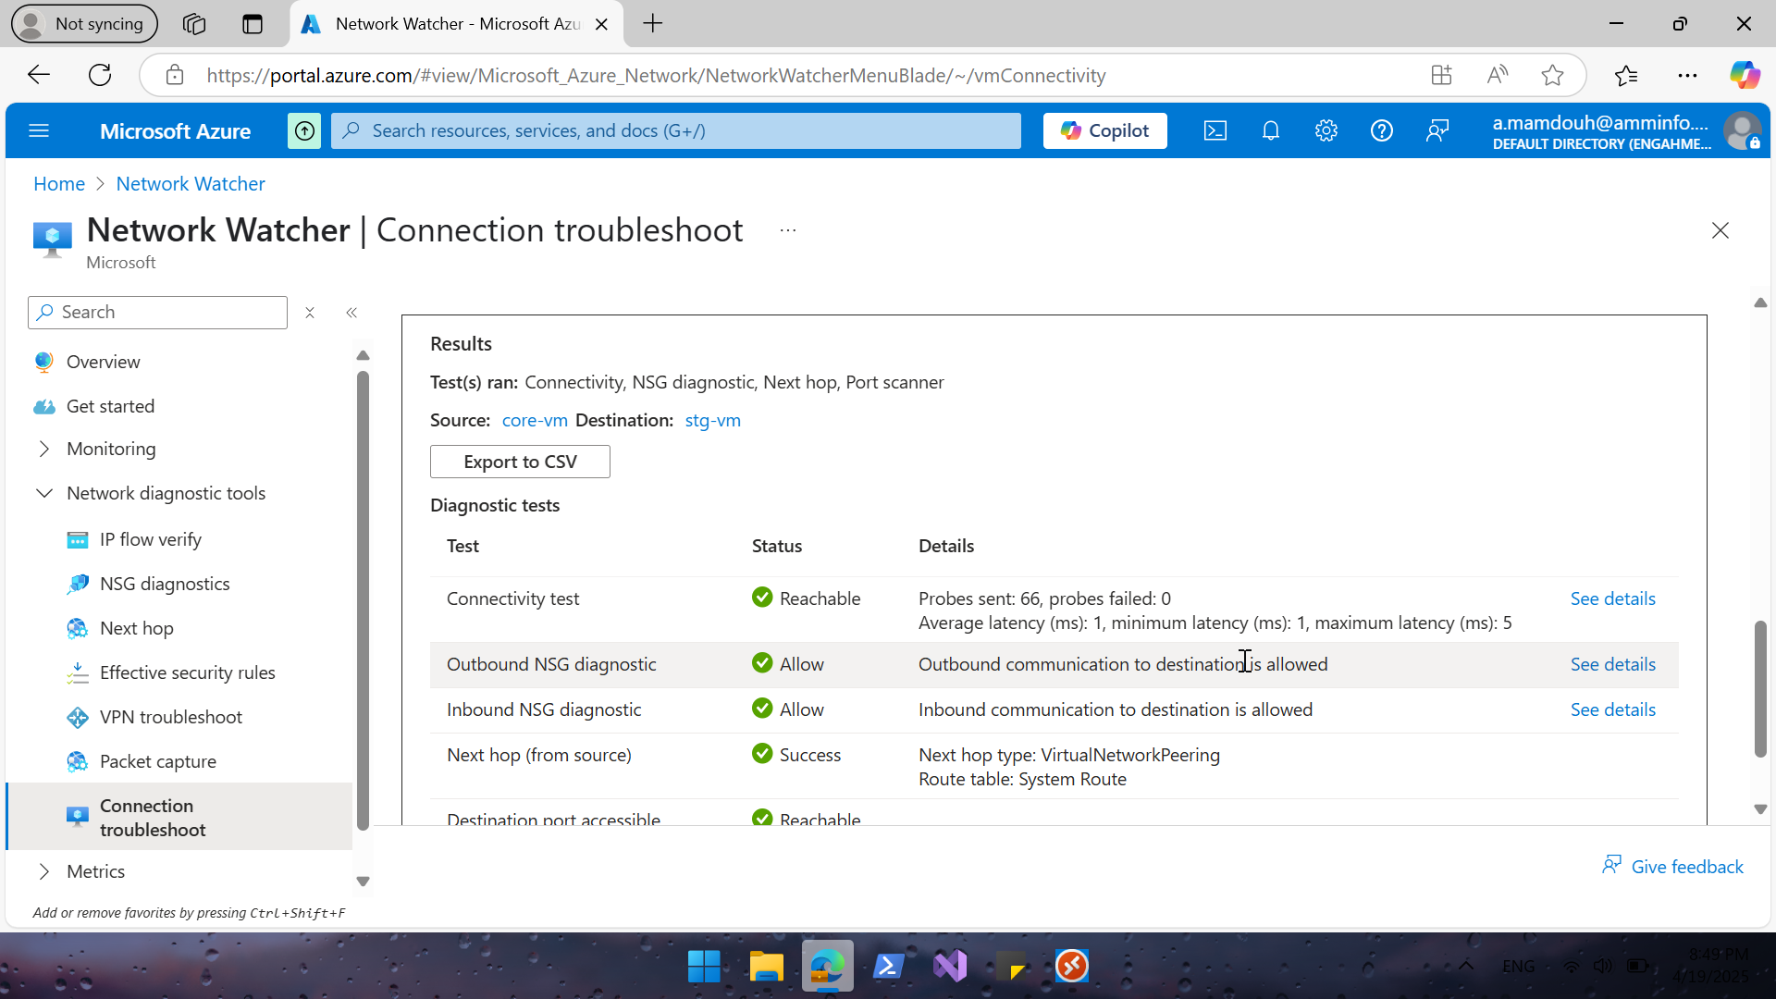
Notes:
Test connectivity between 2vm as before | connection succeeded

Slide 29
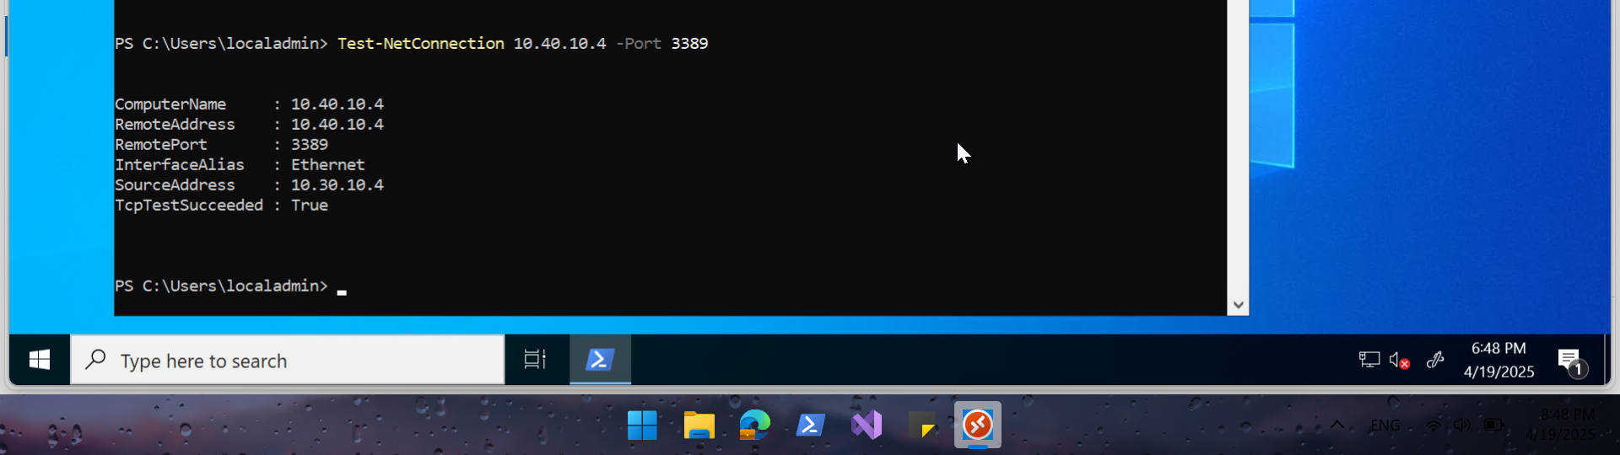
Notes:
Using test connection | connection succeeded

